Slide 1
AGENDA
1- WHAT IS LARGE LANGUAGE MODEL
2- HOW DOES LLM WORKS
- LLM TOKENIZER
- LLM EMBEDDING
- TRANSFER LEARNING
- ATTENTION
- PRE-TRAING & FINE-TUNNING
3- COMPARISION OF LLM & PRICING
4- KEY STEPS OF LLM
- DATA CURATION
- MODEL ARCHITECTURE
- TRAINING AT SCALE
5- WHY WE CALLED LARGE IN LARGE LANGUAGE MODEL
- PROMPT DESIGN
- FEW SHOT LEARNING & ZERO SHOT LEARNING
6- OPEN-AI API KEY GENERATION
7- INTRODUCTION TO LANGCHAIN
8- EXPLORE THE DATASET USING LANGCHAIN (PRACTICLE)
9- TOP LLM MODEL’S
10- FREQUENCY ASKED QUESTION
11- TRENDING LLM APPLICATION & REAL TIME APPLICATION OF LLM
12- PREVIOUS WORKSHOP LINK & NEW BATCH COURSE LINK

Slide 2

1- WHAT IS LARGE LANGUAGE MODEL
Every one of us is aware of the popular and powerful AI tool ChatGPT by OpenAI.
Every company is utilizing its power, and every software tool is powered by it.
It can generate answers, debug code, summaries text, etc.
But how is it more powerful ?
because it is a chatbot powered by one of the popular large language models, GPT 4 (initially, it was powered by GPT 3.5) to provide users with natural language responses to their queries.
Let us see what exactly a large language model is ?
A large language model is an artificial intelligence (AI) system designed to process and understand natural language, such as human speech and text.
A large language model (LLM) is a type of artificial intelligence model that is trained on a massive dataset of text.
This dataset can be anything from books, articles to websites, dictionary and social media posts.
The LLM learns the statistical relationships between words, phrases, and sentences in the dataset, which allows it to generate text that is similar to the text it was trained on.
Large language models are trained on massive amounts of text data, often including the entire internet or a large subset of it.
This allows the model to learn patterns and relationships between words, phrases, and sentences, enabling it to generate coherent and meaningful language output.

Slide 3
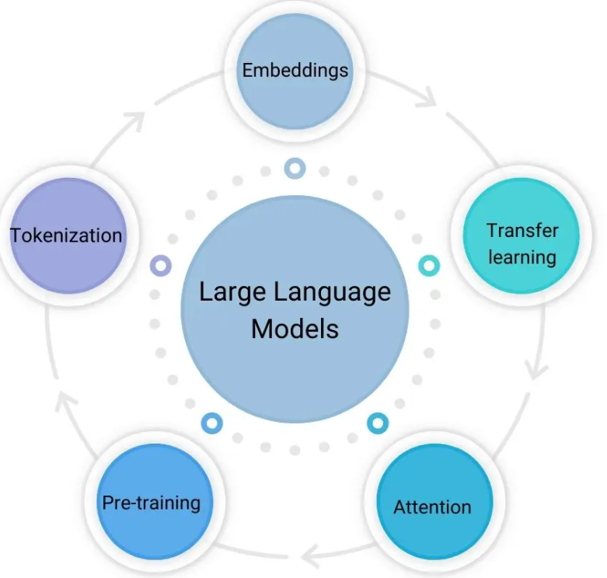
2 - HOW DOES LLM WORK :- - LLM TOKENIZER - LLM EMBEDDING - TRANSFER LEARNING - ATTENTION IN LLM - PRE-TRAINING

Slide 4
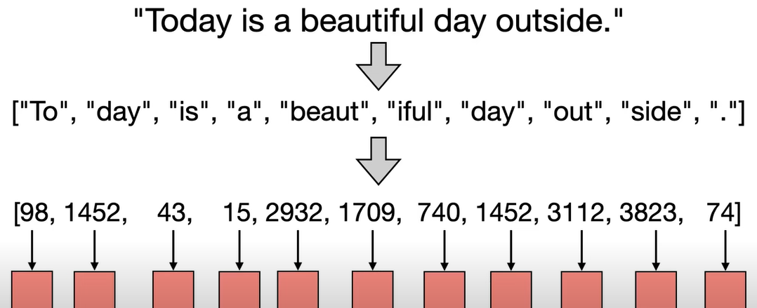
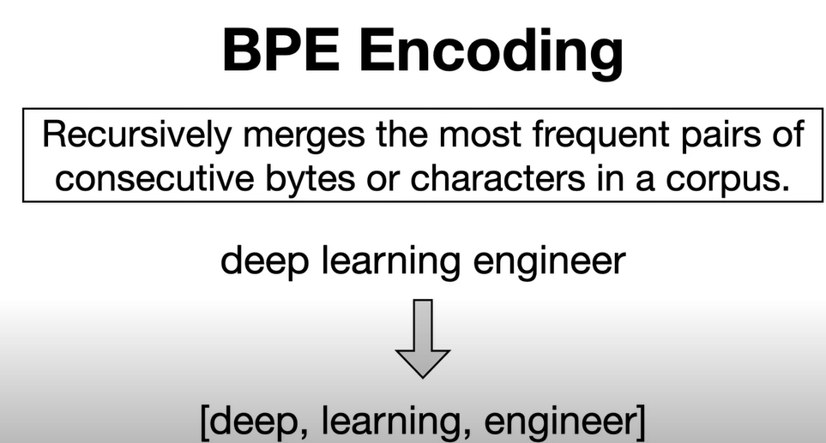
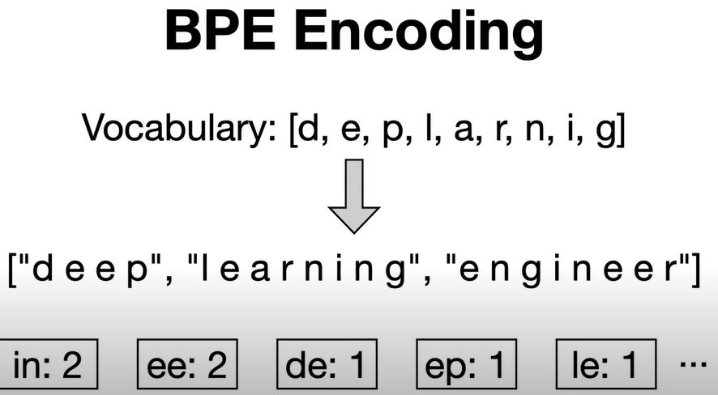
LLM TOKENIZERS
Split the sentence to text or sub word Which are
converted to ID’s through lookup table, further on
each each ID’s represent in entry in embedding
matrix that is used model for represent for specific
token.
1- BPE (BYTE PAIR ENCODING)
2- WORD PIECE
3- SENTENCE PIECE

Slide 5
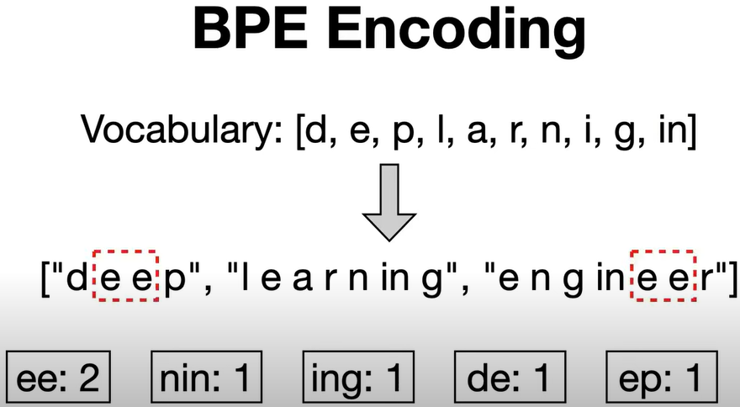
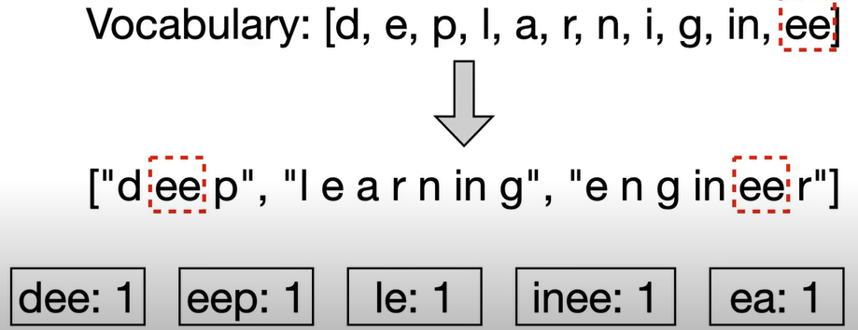
- Deep learning engineer is divide into 3 words. We initialized vocabulary to all individual character.
- Each character divide by space then iteratly merge most frequent characters which hear in repeats 2 time, ee repeats 2 time rest of the frequence is 1.
- Let’s merge the group into vocabulary. Next repeat the process , merge the token calculate the token.
- Keep add to the vocabulary. Keep doing till we reach the desired vocabulary.
- So manually these thing cant possible.
- That’s we will do this process using library (HUGGING FACE)

Slide 6
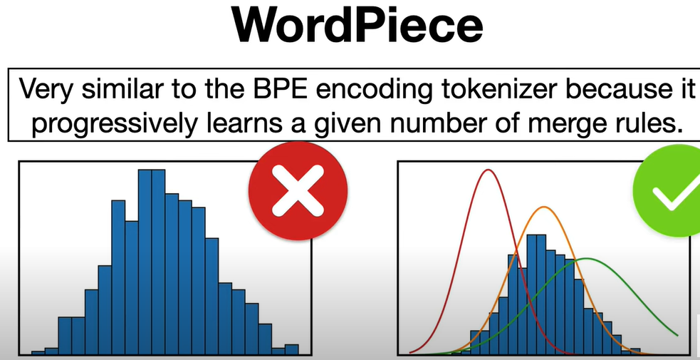
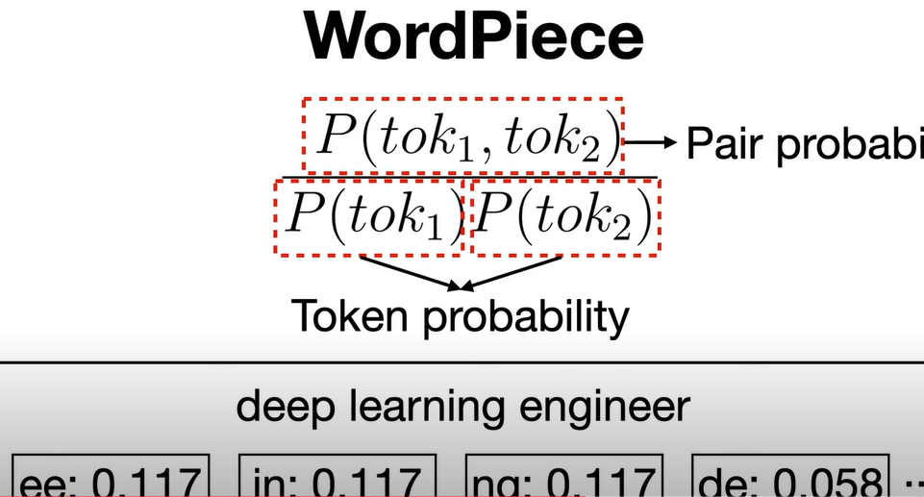
- BPE We choose frequency
- Word piece we don’t choose frequency we will choose maximum likelihood for the training data added to vocabulary
- maximise likehood of the trining data is equal to pair probability/ token probability
- in BPE we got frequency but in wordpiece we will be using probability freaquency

Slide 7
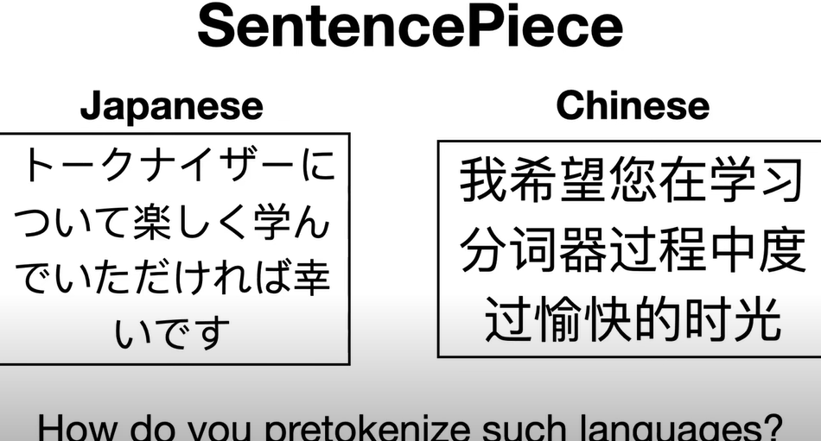
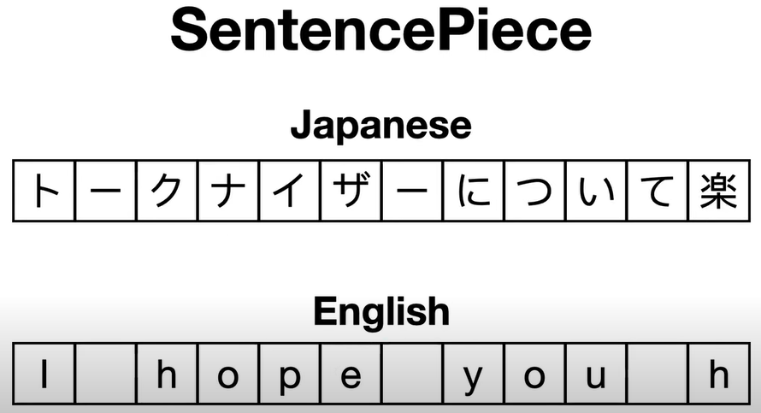
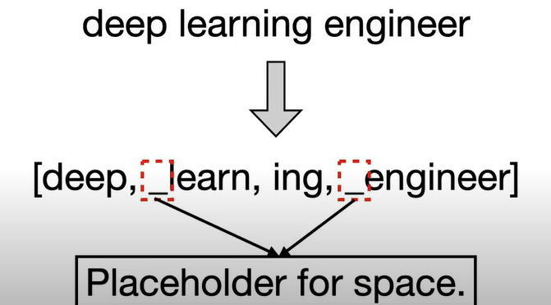
- Assume you want to apply BPE encoding to Japanese or
Chinese no space is available.
- So need to implement different pretokenize such languages.
- The sentence piece tokenizer try to solve this issue by
treating input text as character white space included and
it does that by apply same merging algorithm as bpe or
unigram tokenizer. Result output after apply sentencepiece
tokenizer & you can see _ before certain tokens place holder
for space which compare to BPE or wordpiece tokenizer
allow to concating the tokens . This is how tokenizer works
- Sentence piece tokenizer used in T5 | ALBERT | ROBERTA etc.

Slide 8
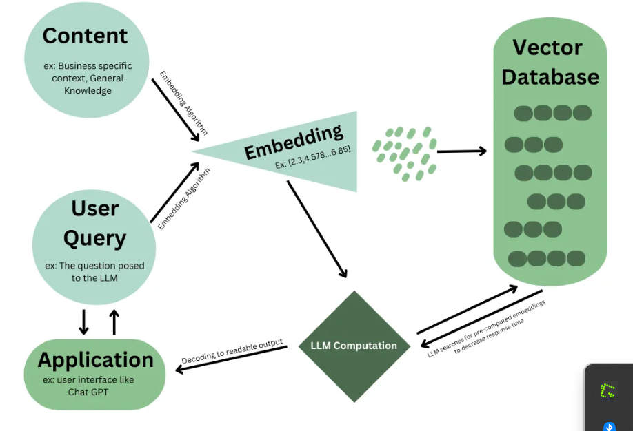
LLM EMBEDDING
In the context of large language models, embeddings are vectors stored in an index within a vector database.
Embeddings are a way to store data of all types (including images, audio files, text, documents, etc.) in number arrays called vectors.
The most efficient way to store a vectorized index is in a vector database, also sometimes referred to as vector store.
Unlike traditional databases that store information in rows and columns, vector databases use an algorithm to index the vectors.
In a vectorized database, function approximation is used to look for the most similar vector to the query — this process is called Retieval Augmented Generation (RAG).
Mathematically, an embedding space, or latent space, is defined as a manifold in which similar items are positioned closer to one another than less similar items. In this case, sentences that are semantically similar should have similar embedded vectors and thus be closer together in the space.

Slide 9
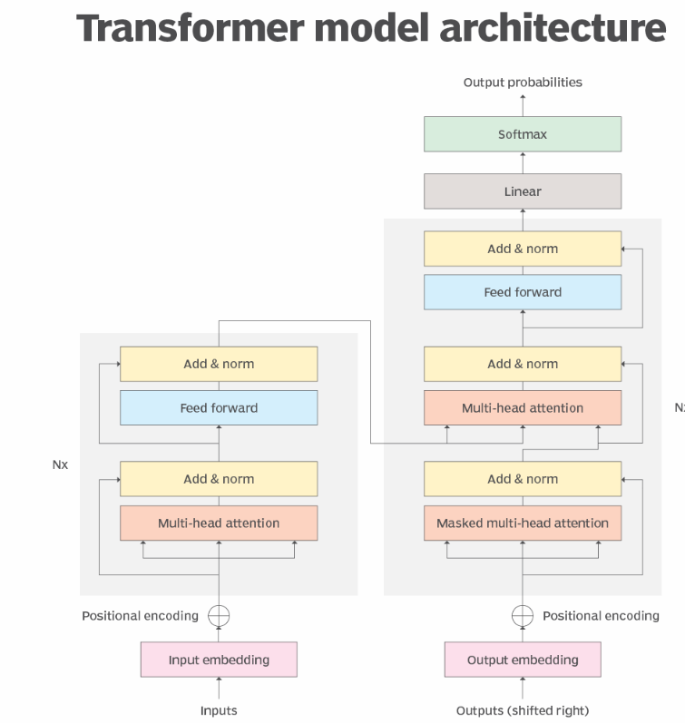
TRANSFER LEARNING

Slide 10
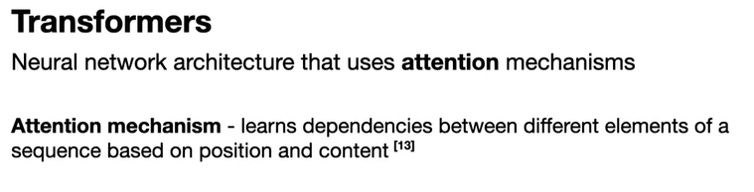
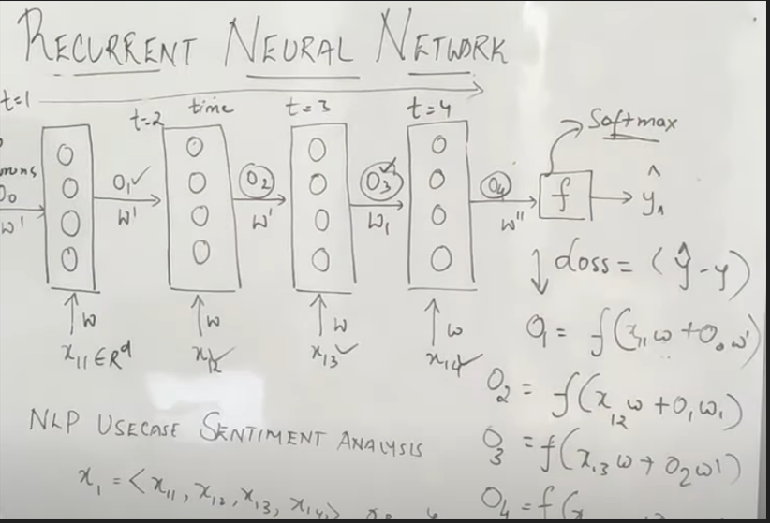
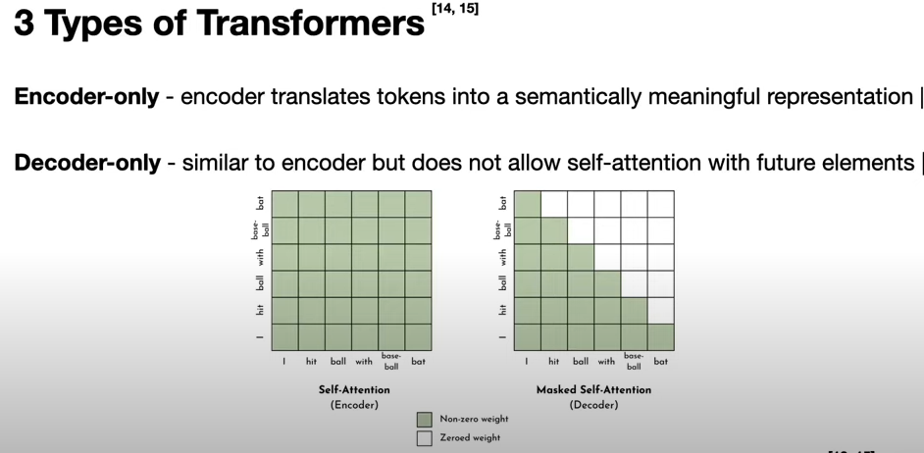
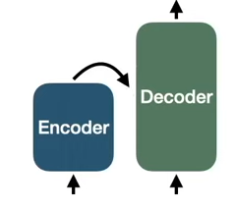
ENCODER – DECODER : combination of both
RNN NEURAL NETWORK (SEQ2SEQ MODEL)

Slide 11
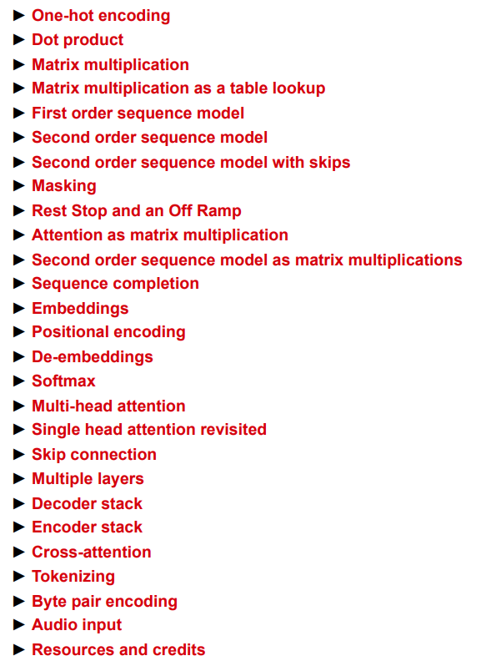
LIST OF TRANSFORMER FROM BASIC

Slide 12
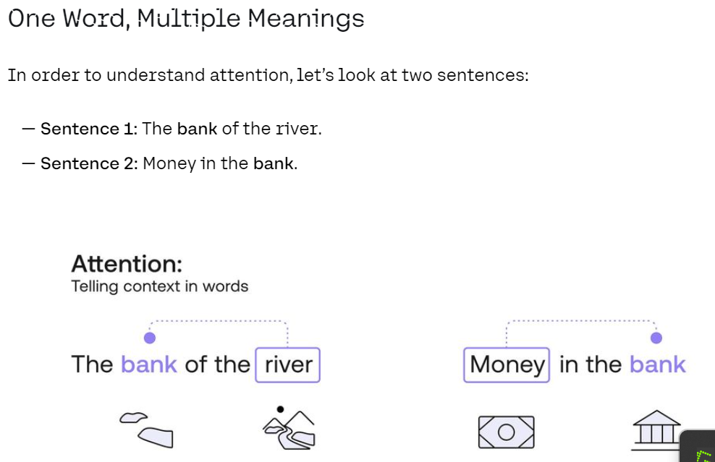

ATTENTION IN LLM(Simple Self Attention & Multihead Attention)
- A huge roadblock for language models is when a word can be used in two different contexts.
- When this problem is encountered, the model needs to use the context of the sentence in order to decipher which meaning of the word to use. This is precisely what self-attention models do.
- How would a computer know that the word “bank”
in the first sentence refers to a setting in nature, and
in the second sentence to a financial setting?
- Well, let’s ask a simpler question:
How would a human know this?
How did you figure out these two settings?
- The way you and I did it was probably to look
at the neighboring words.
-In the first sentence, the word “river” was the one
that hinted at the nature setting and in the second
sentence, the word “money” was key to the financial setting.
- So in short, we need a way to use the other words in the
sentence to understand what context of the word “bank”
we want to use.
- So finally we modified to 2 sentence.

Slide 13
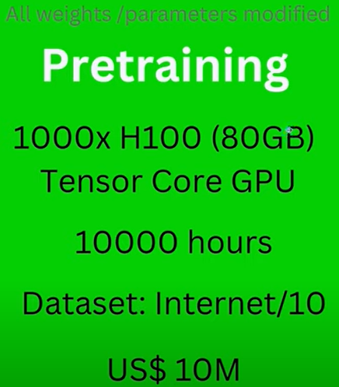
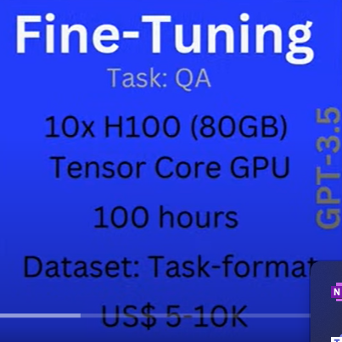
PRE-TRAINING & FINE-TUNNING IN LLM
PRE-TRAINNING (GPT):
For pretrain user required 1000 * H100 tensorcore gpu from nvidia each with 8GB ( while train in GPT-X)
Minimum training time is 1k – 10k hrs
Required large dataset about 10th of internet
To train these dataset in cloud it required 10m dollars in gpt 3.5
FINE-TUNNING (GPT)
For fine tunning required system infrastructure of 10*H100(80GB)
100 hr in the cloud
Dataset is specific format e.g if the dataset is QA then train (q1-a1 || q2-a2 || q1m-a1m)
Cost is 5-10 for fine tunning

Slide 14
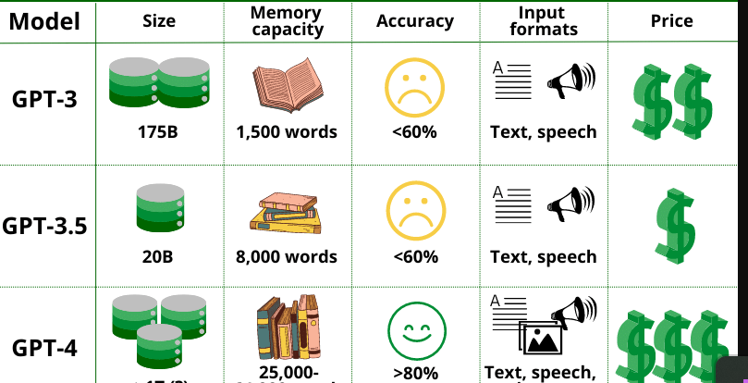

Slide 15
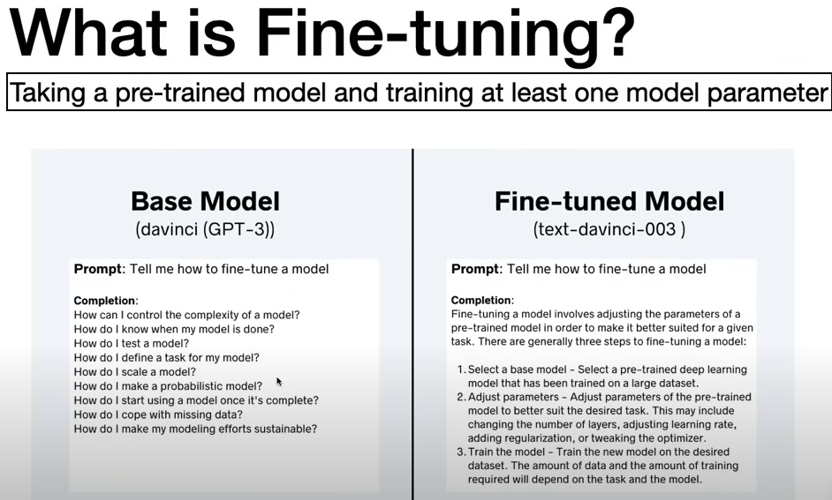

Slide 16
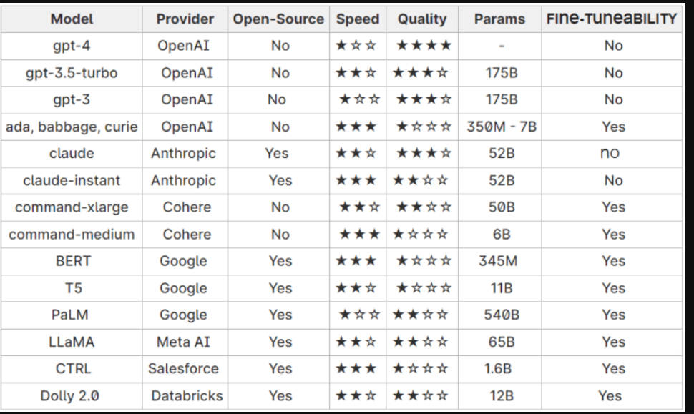
COMPARISION OF LLM & PRICING

Slide 17
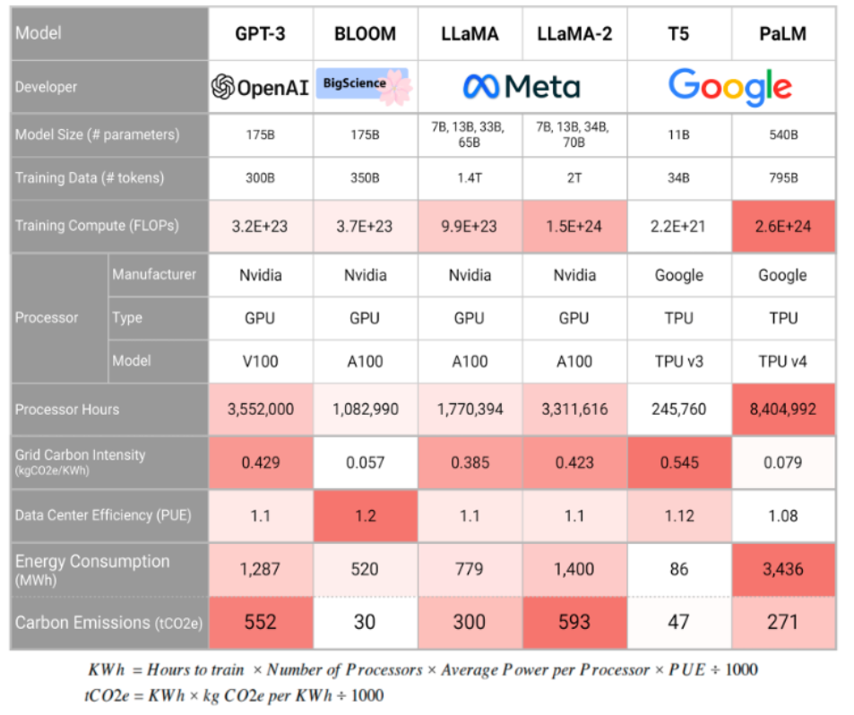

Slide 18
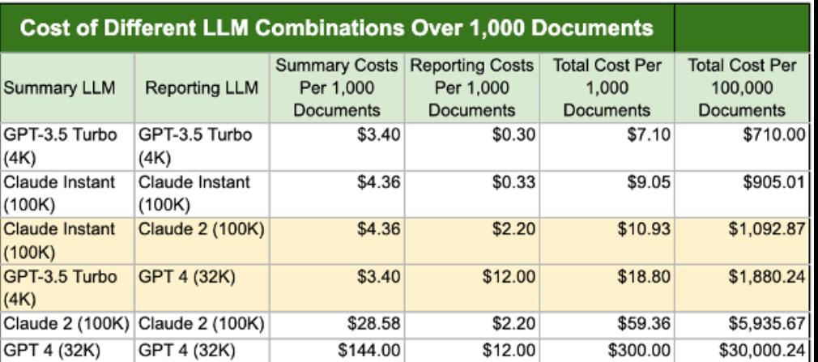

Slide 19
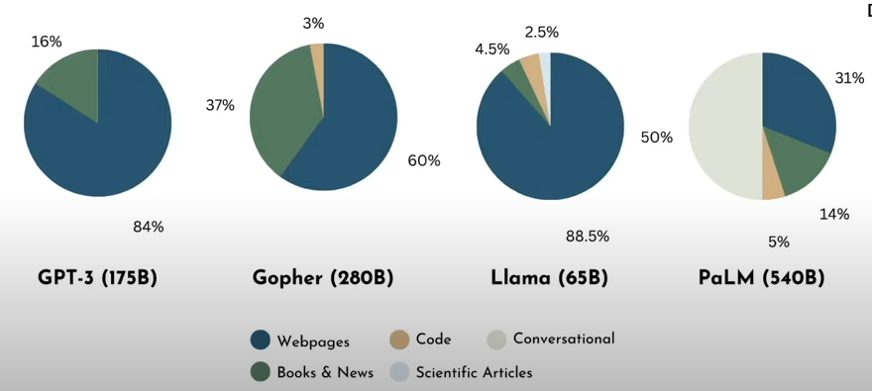
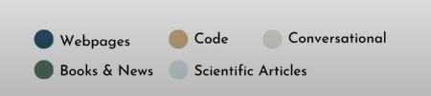
4: KEY STEPS LLM:
- DATA CURATION
- MODEL ARCHITECTURE
- TRAINING AT SCALE

Slide 20
WHAT IS DATA CURATION ?
Data curation is data management both involves the organization, cleaning, maintaince of data to ensure its usability, accessibility & longevity.
Where do we get all these data ?
INTERNET (webpages, Wikipedia, forums, books, scientific article, dictionary, blogs etc
Public dataset (Common Crawl - Open Repository of Web Crawl Data , The Pile, Hugging face Datasets
Private data sources (Bloomberg GPT) etc
How do we prepare the data ?
QUALITY FILTERING – remove low-quality text from the dataset
DE-DUPLICATION – several instances of same(very similar text can biased model and disrupt training.
PRIVACY REDACTION- removal of sensitive and confidential information
TOKENIZATION- translate text into number

Slide 21
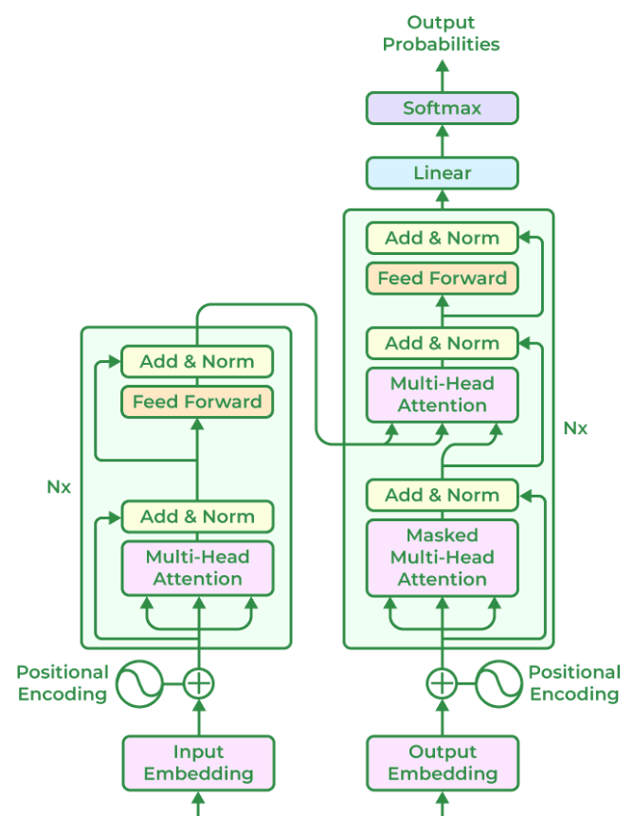
MODEL ARCHITECTURE
1- Encoder
2- Decoder
3- Encoder – Decoder ( Seq2Seq Model)
4- Other Design choices areas
Residual Connection :
Allow intermediate Training values to by
pass hidden layers
Layer Normalization :
Rescale the values Between mean & standard
deviation
Activation Function :
Non-linear Activation
Function GELU, RELU, SWISH
POSITION EMBEDDING –
Self attention positional encoding

Slide 22
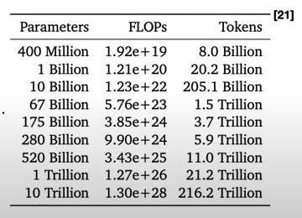
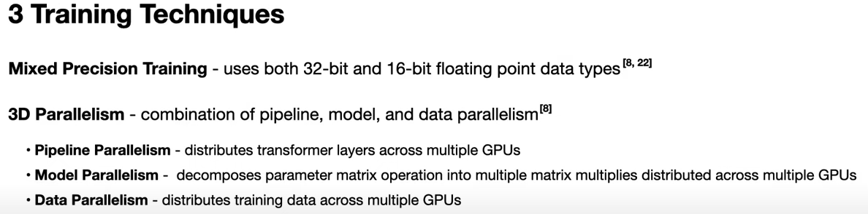
TRAINING LLM MODEL
- If model is too big or trained too long it can overfit
- If model is too small or not trained long enough, then underfit
- 20 tokens per model parameter underfit
- 100x increase in FLOPs for each 10x increase in model
parameter then overfit.

Slide 23
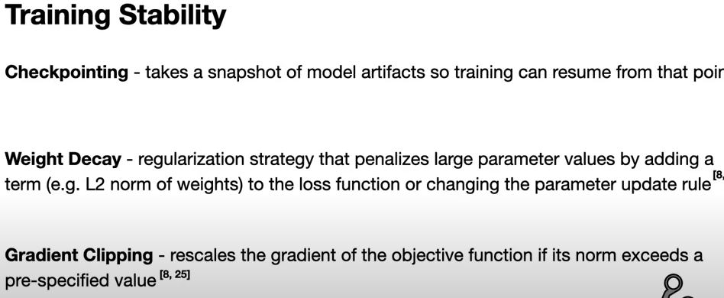
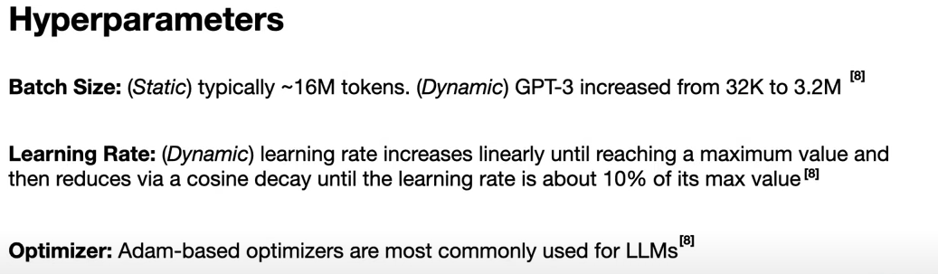
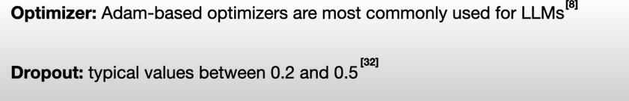

Slide 24
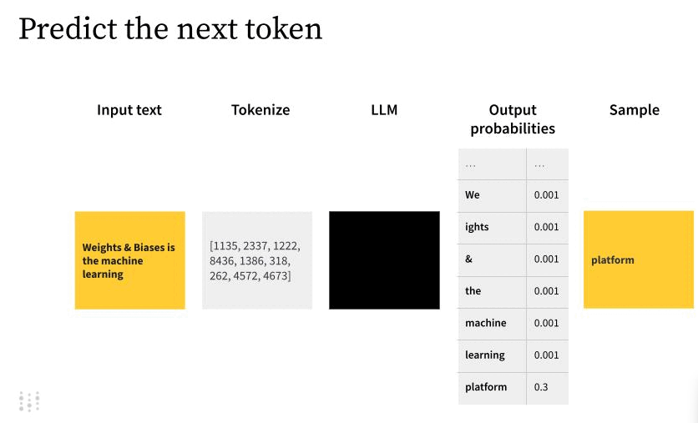
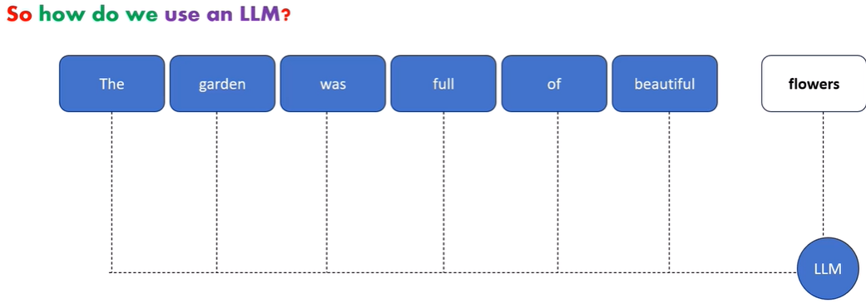
5- Why we call large language models? Why large?
LLM called as ‘large’ because of the size and complexity of neural network, as well as size of the dataset that was trained on.
Researcher started to make these models large and train them on huge datasets that they started showing impressive results like understanding complex natural language and generating language & It predict the probability of next token

Slide 25
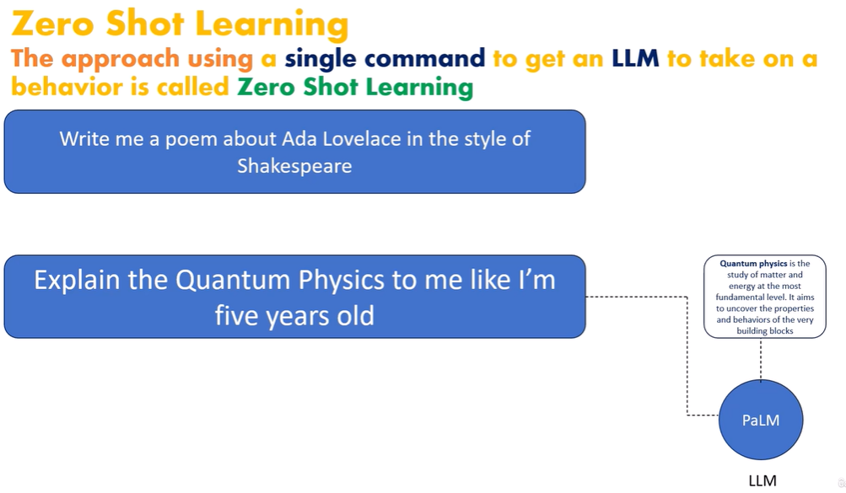
PROMPT DESIGN IN LLM
All the text that we feed into an LLM as input is called prompt & this process known as PROMPT DESIGN, which is about figuring out how to write and format prompt text to get LLM’s to do what user want.
Using prompt, it predicts the next word of the sentence which we discussed today.

Slide 26
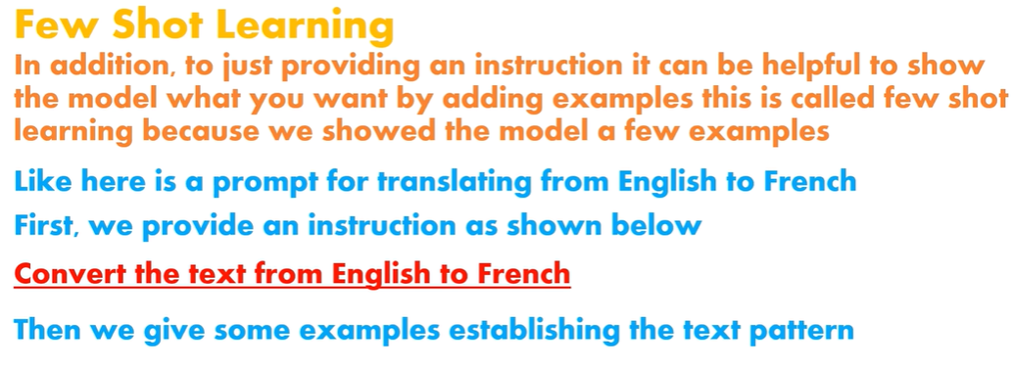
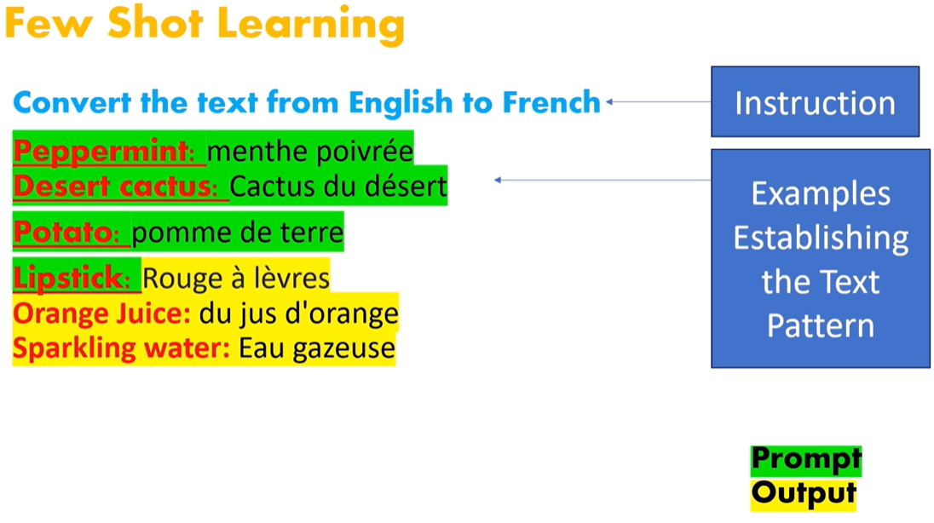

Slide 27
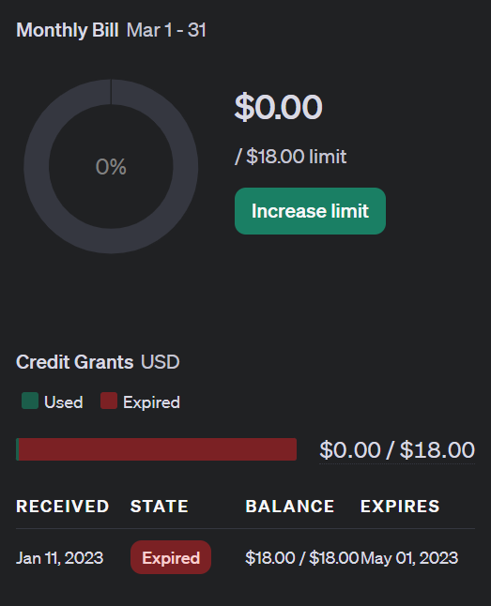
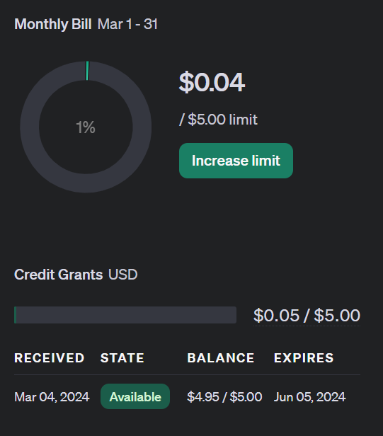
6- OPEN-AI API KEY GENERATION
1- Create a login using open-ai ➔ https://openai.com/
2- Click on try chatgpt
3- https://platform.openai.com/organization/usage4-
Usage (check your usage limit) because this
is not an open source
5- If usage limit is over then you will get error
RATELIMIT error
6- If you get this error you can create you
open ai
with different Gmail account & with different
phone Number
7- for work with more token user must need to pay to avail the service
8- open AI is not an open source

Slide 28
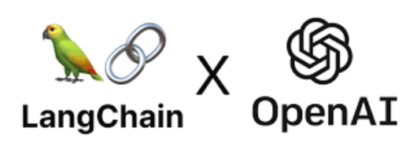
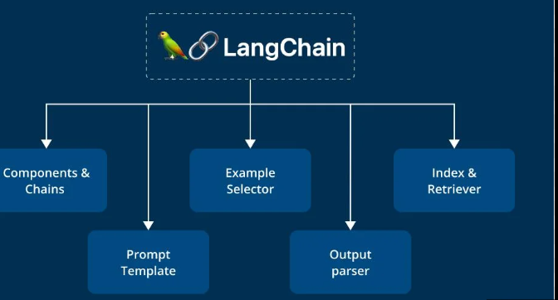
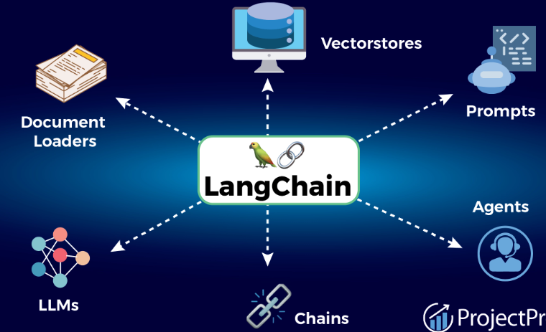
8- WHAT IS LANGCHAIN?
- Lang Chain is a framework designed to simplify the creation of applications using large language models.
- As a language model integration framework, Lang Chain's use-cases largely overlap with those of language models in general, including document analysis and summarization, chatbots, and code analysis.
Refer to the LangChain Documentation ➔ https://www.langchain.com/
https://python.langchain.com/docs/get_started/installation

Slide 29
9- EXPLORE THE DATASET USING LANGCHAIN & OPEN-AI (PRACTICLE)
VS CODE
OPEN AI
LANGCHAIN
PANDAS
DATASET – TITANIC SURVIVAL

Slide 30
9- TOP LLM MODEL
Large Language Model commonly known as an LLM, refers to a neural network equipped with billions of parameters and trained extensively on extensive datasets of unlabeled text. This training typically involves self-supervised or semi-supervised learning techniques.
1- OPEN AI (GPT-4) :
As of 2024, OpenAI’s GPT-4 stands out as the leading AI Large Language Model (LLM) in the market.
GPT-4 has exceptional capabilities of excelling in complex reasoning, advanced coding, proficiency in various academic domains,
Notably, it’s the first multimodal model accepting both text and image inputs. and achieving human-level performance in diverse skills.
2- OPEN AI (GPT-3) :
GPT-3 is an OpenAI large language model, released in 2020 stands out as a groundbreaking NLP model, boasting a record-breaking 175 billion parameters—the highest among NLP models.
3- OPEN AI (GPT-3.5) :
GPT-3.5 represents an enhanced iteration of GPT-3, featuring a reduced parameter count.
GPT-3.5 serves as the underlying technology for chatgpt with various models available, including the highly capable GPT-3.5 turbo, as highlighted by OpenAI.

Slide 31
4- GOOGLE(GEMINI) : Google’s new AI, GEMINI, compete ChatGPT. Released in December 2023 it was built from the ground up to be multimodal, which means it can generalize and seamlessly understand, operate across and combine different types of information including text, code, audio, image and video. With a score of 90.0%, Gemini Ultra is the first model to outperform human experts on MMLU (massive multitask language understanding), which uses a combination of 57 subjects such as math, physics, history, law, medicine and ethics for testing both world knowledge and problem-solving abilities. Developers and enterprise customers can access Gemini Pro via the Gemini API in Google AI Studio or Google Cloud Vertex AI. 5- GOOGLE (BARD): (Google Bard stands as an experimental conversational AI service driven by LaMDA (Language Model for Dialogue Applications), a project undertaken by Google AI. Google rebrands BARD AI to GEMINI AI 6- GOOGLE (PALM-2): PaLM 2 is a large language model (LLM) developed by Google AI. Google has elevated the capabilities of PaLM 2 by emphasizing various aspects, including commonsense reasoning, formal logic, mathematical equations, and advanced coding, spanning over 20 languages. PaLM 2 is purportedly trained on a massive 540 billion parameters.

Slide 32
5- META AI (LLaMA) : LLaMa, or Large Language Model Meta AI, emerges as a significant development in the realm of Large Language Models by Meta AI. The inaugural release of LLaMa in February 2023, with the largest version of 65 billion parameters in size. Meta’s introduction of the LLaMa family of large language models (LLMs) has become a valuable asset for the open-source community. The diverse range of LLaMA models, spanning from 7 billion to 65 billion parameters, has demonstrated superior performance compared to other LLMs, including GPT-3, across various benchmarks. 6- CLAUDE V1: It’s not as popular LLM as compared to GPT or Llama but Claude is a powerful LLM developed by Anthropic, former co-founded by OpenAI employees. It’s a newbie on the Large Language Model block that’s outperforming PaLM 2 in benchmark tests and offering a 100k token context window for the first time ever. It’s in competition with GPT-4 and scored 7.94 in the MT-Bench test, while GPT-4 scored 8.99 and in the MMLU benchmark as well, Claude v1 secures 75.6 points, and GPT-4 scores 86.4. Previously said that is offers 100k tokens which is equivalent to about 75,000 words, this means that you can easily load a full-length book into Claude’s context window, it would still understand it and create text in response to your prompts. 7- FALCON Its an open source model which has outranked all the other open-source models released so far, including LLaMA, StableLM, MPT, and more. Notably, Falcon LLM underwent training (on AWS Sagemaker) on an extensive dataset comprising web text and curated sources. model developed by the Technology Innovation Institute(TII).

Slide 33
10- FREQUENTLY ASKED QUESTION
1- What is Large Language model
Large Language Model is a powerful artificial intelligence system trained on vast amounts of text data.
2- What is a LLM in AI?
In AI, LLM refers to Large Language Models, such as GPT-3, designed for natural language understanding and generation.
3- What are the best Large Language Models?
Open AI, ChatGPT Trained by GPT-3, GPT-4.
4- How does LLM model work?
LLMs work by training on diverse language data, learning patterns, and relationships, enabling them to understand and generate human-like text.
5- What is an example of an LLM model?
GPT-3 (Generative Pre-trained Transformer 3) is an example of a state-of-the-art large language model in AI.

Slide 34

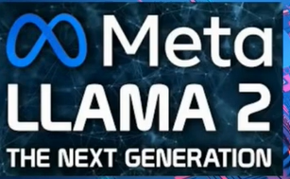
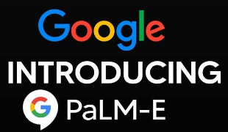
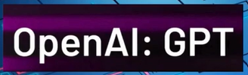
11 - TRENDING LLM APPLICATION
https://gemini.google.com/app
https://openai.com/

Slide 35
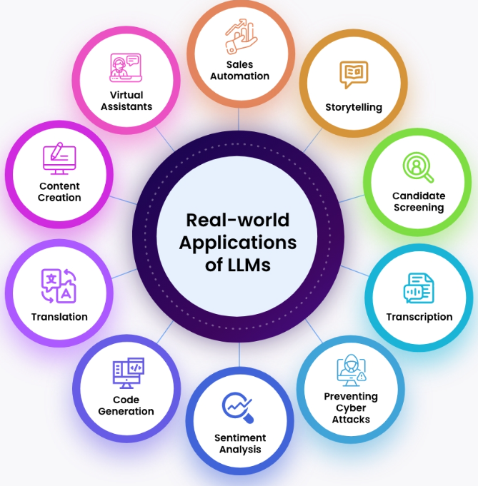

Slide 36
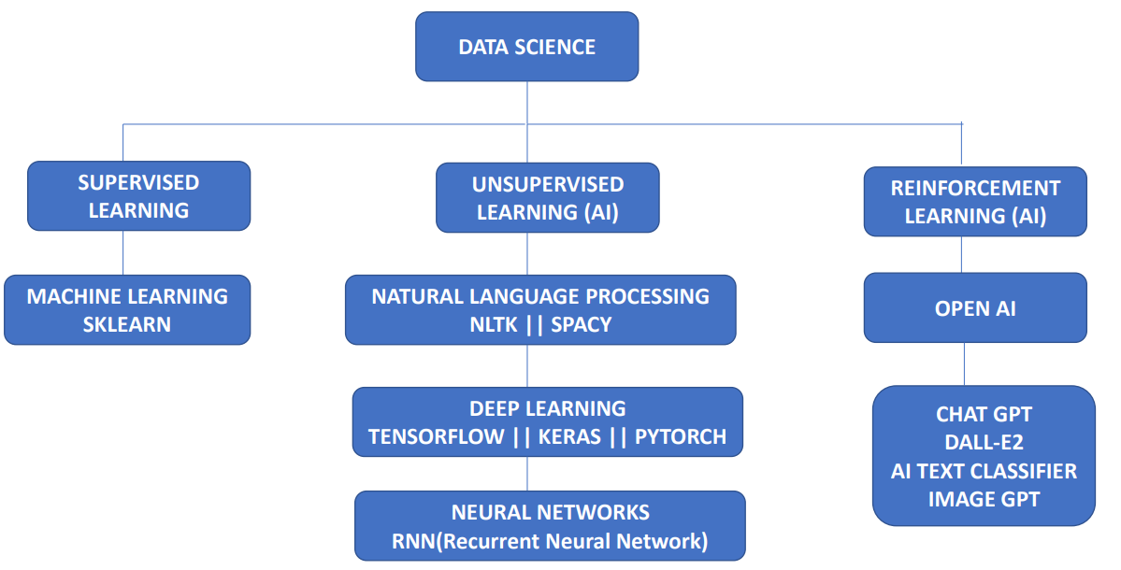

SUPERVISED LEARNING vs UNSUPERVISED LEARNING vs REINFORCEMENT LEARNING
(LLM)

Slide 37



